Slide 1


Analyze bank Data for Improving Banking System
Improve the banking system by analyzing customer data to enhance marketing strategies, customer segmentation, and loan service optimization.

Slide 2


Why Are We Doing This Project?
Improve Customer Experience Target the right people with the right message at the right time.
Boost Bank Profitability
Encouraging the right people to invest in term deposits or take loans can improve the bank’s revenue
Predict Future Actions
Build predictive models to forecast which customers are likely to respond positively, so the bank can act proactively.
Leverage Data for Strategic Decisions Data science empowers smarter marketing, not just more marketing.

Slide 3

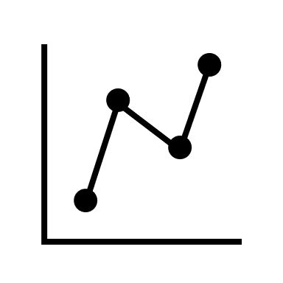

Project Objectives
Data Cleaning & Preprocessing
→Handle missing or unknown values
→Remove negative balances & outliers
→Encode categorical features
→Normalize numerical data
Exploratory Data Analysis (EDA)
→Understand feature distributions
→Discover patterns in campaign outcomes
→Investigate feature correlations with target
Modeling and Evaluation
Train and compare multiple machine learning models

Slide 4
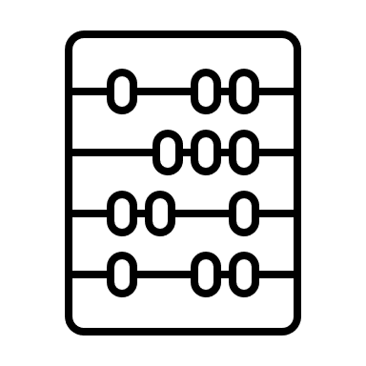
Dataset Overview
Source: UCI Machine Learning Repository Total Records: 45,211
Age → The age of the client.
Job → The job type (e.g., management, technician).
Marital → The marital status (e.g., married, single).
Education → The education level (e.g., primary, secondary, tertiary).
Balance → The bank balance of the client.
Housing → Whether the client has a housing loan (yes/no).
Loan → Whether the client has a personal loan (yes/no).
Contact → Type of communication contact (e.g., cellular).In Seaconds
Day → The last contact day of the month.
Month → The last contact month of the year.
Duration → Duration of the last contact in seconds.

Slide 5
Analysis Goals
📍 Make the customers loyal as possible
🎯 Smarter Marketing Focus
👥 Identify high-potential customer segments
💸 Lower Marketing Costs
🚫 Avoid wasting resources(Time , Money) on low-probability customers

Slide 6
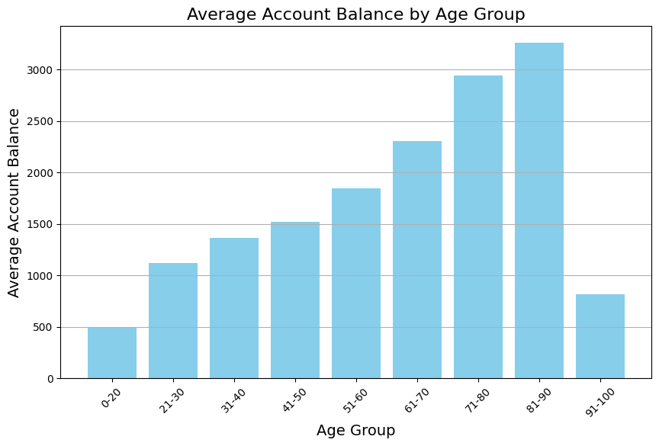
Analysis of Question : How does age correlate with account balance?
that older individuals tend to have higher account balances. Younger clients generally have lower account balances

Slide 7
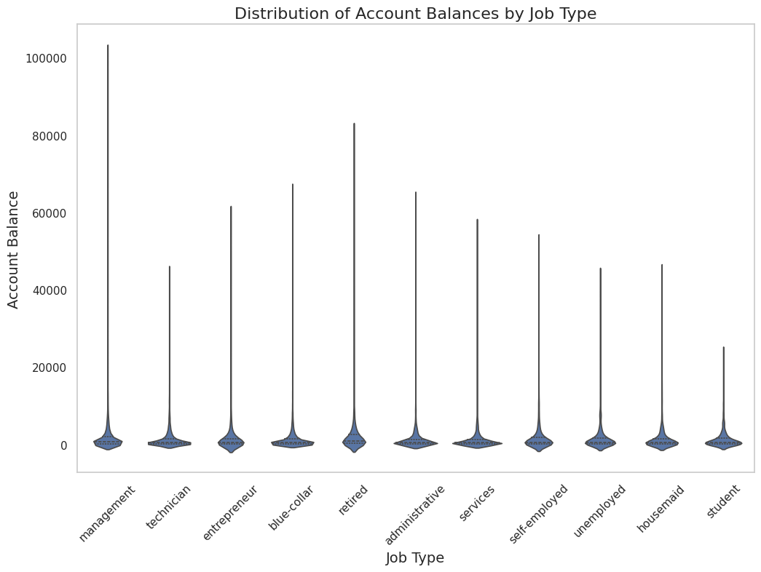
Analysis Question 2: Is there a significant difference in balances between different job types?
Yes There Are a Difference Management/Entrepreneurs tend to have significantly higher savings, reflecting higher earnings. Students/Unemployed show minimal balances, indicating financial constraints.

Slide 8
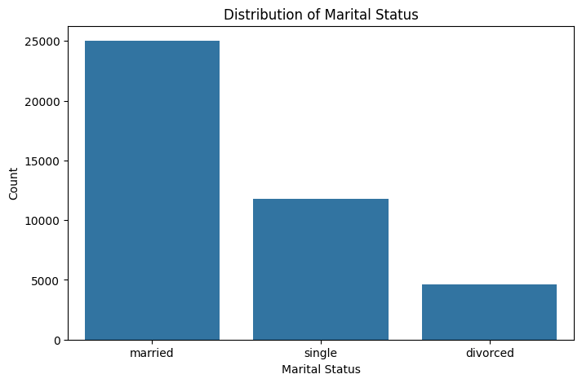
Product Development
Focus on Family and Relationship Services: family accounts, educational savings plans for children
→Family Life Insurance Plans: Coverage that includes multiple beneficiaries and flexible options. Health Savings Accounts

Slide 9
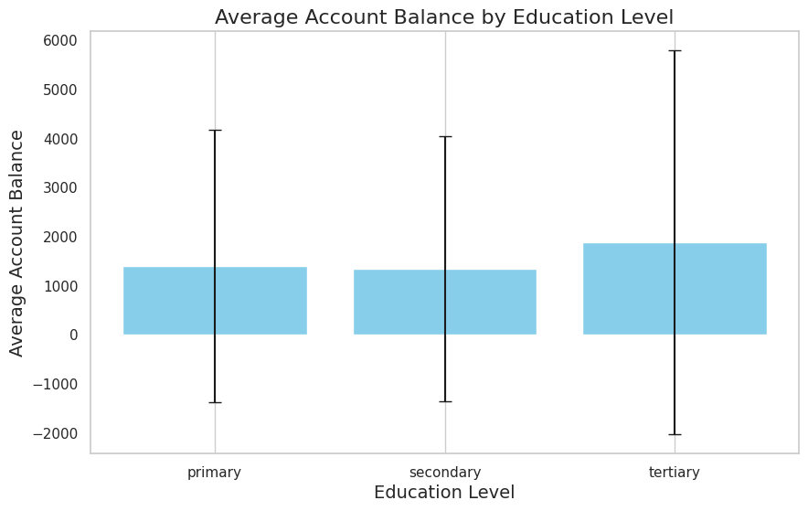
Analysis Question
How does the education level impact the likelihood of having a higher balance?
Tertiary Education has the highest average account balance
Secondary Education has a lower average balance .
Primary Education has the lowest average balance, appearing to be negative

Slide 10
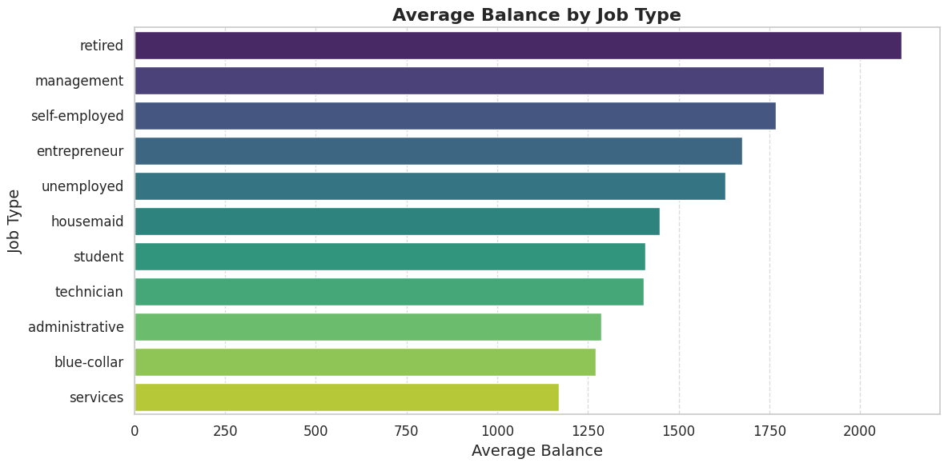
The Overview 👇
Highest Average Balance: The retired
category has the highest average balance ,
around 2,000, indicating that retirees generally have more savings.
Retirement Accounts: Offer high-yield savings accounts or investment products specifically
designed for retirees , which provide competitive
interest rates: tailored to preserve and grow their savings.
Offering high interest rates To keep them loyal

Slide 11

🔎 Key Findings & Recommendations
👵🏽👴🏼 Age & Balance Correlation
Older clients (especially retirees) maintain higher balances → 🎯 Target with high-yield retirement accounts 💰📈
💼 Job Type Insights
Management/Entrepreneurs have highest balances → 🌟 Premium services & wealth management
Students/Unemployed show low balances → 📚 Financial literacy programs
🎓 Education Impact
Tertiary-educated clients have highest balances → 📊 Tailored investment products
Primary-educated clients often in debt → 🛡️ Overdraft protection & savings incentives

Slide 12

🏦 Loan Behavior
Job type strongly influences loan uptake → 🎯 Customized loan marketing by profession
Blue-collar? → 🛠️ Equipment loans
Managers? → 💼 Business expansion loans
👧👦 Marital Status
Married clients dominate dataset → 🏡 Family-focused financial products
Joint accounts
Education savings plans
Family insurance bundles

